Slide 1


SQL CAPSTONE PROJECT

Slide 2
CONTENTS
Business problem
Business objectives
Data wrangling
Feature engineering
Exploratory data analysis
Product analysis
Sales analysis
Customer analysis
Suggestions

Slide 3
BUSINESS PROBLEM
The major aim of this project is to gain Insight Into the sales data of amazon, to understand the different factors that effect sales of the different branches.

Slide 4
BUSINESS OBJECTIVES
OBJECTIVE:
The primary business objective is to optimise amazon sales
Enhance customer satisfaction
Maximizing profits in sales
Improving the market competitiveness

Slide 5

DATA WRANGLING
DATA COLLECTION
Collected data from excel files.
ABOUT THE DATA
It is a structured data
No missing or null values
DATA DIMENSIONS
1000 rows and 17 columns are present in the data
IDE TOOLS
My sql workbench

Slide 6
COLUNM NAMES
invoice_id
branch
city
customer_type
gender
product_line
unit_price
quantity
VAT
total
date
time
payment_method
cogs
gross_margin_percentage
gross_income
rating

Slide 7
COLOUMN NAME | DESCRIPTION
invoice_id | Invoice of the sales made
branch | Branch at which sales were made
city | The location of the branch
customer_type | The type of the customer
gender | Gender of the customer making purchase
product_line | Product line of the product sold
unit_price | The price of each product
quantity | The amount of the product sold
VAT | The amount of tax on the purchase
total | The total cost of the purchase
date | The date on which the purchase was made
time | The time at which the purchase was made
payment_method | The total amount paid
cogs | Cost Of Goods sold
gross_margin_percentage | Gross margin percentage
gross_income | Gross Income
rating | Rating

Slide 8
Feature Engineering
Added new columns to the data set named as
Time of day
Month
Day name

Slide 9
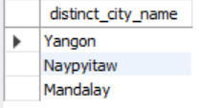

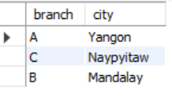
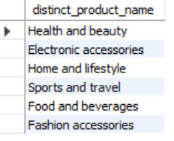
Exploratory Data Analysis
Distinct cities
Branch and corresponding city
Distinct product lines

Slide 10
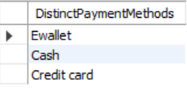

Distinct payment methods
Distinct customer type

Slide 11

PRODUCT ANALYSIS
INSIGHTS OF THE PRODUCT ANALYSIS
Distinct product lines
product line with highest sales

Slide 12
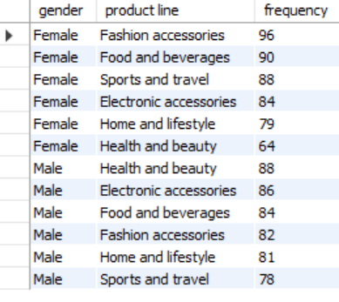
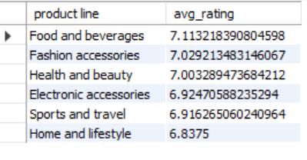
Different Product lines with associated genders
Product lines with highest ratings

Slide 13
City Name | Highest Product line with count | Lowest Product line With count
Mandalay | 1.Sports & Travel (62) | Electronic Accessories (55)
 | 2.Fashion & Accessories (62)
Naypyitaw | 1.Food & Beverages (66) | Sports and travel (45)
 | 2.Fashion & Accessories (65) | Home and lifestyle (45)
Yangon | 1.Home and lifestyle (65) | Health & Beauty (45)
 | 2.Electronic accessories (60)
BranchWise Product Sales Analysis
Branch | Product Line | Highest Sales
A | Home & Lifestyle | 22,421
B | Sports & Travel | 19,989
C | Food & Beverages | 23,771
BranchWise Product Sales Analysis
Branch | Product Line | Lowest Sales
A | Health & Beauty | 12,598
B | Food & Beverages | 15,219
C | Home & Lifestyle | 13,898

Slide 14
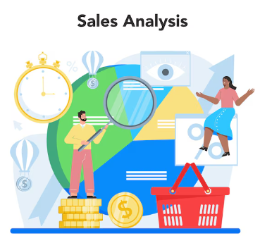
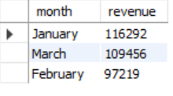
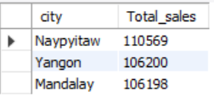
Sales Analysis
INSIGHTS:
Revenue generated in each month
The total sales in the 2019 ---- 3,22,970.
The above result is showing that in the month of January having the highest revenue when comparing to the february&march.
Febraury month revenue was very low i.e --- 97,219.
City with highest sales:
Naypyitaw city generated highest sales than yangon & mandalay.

Slide 15
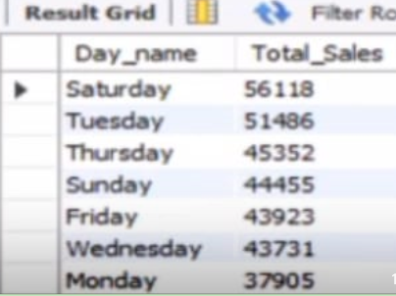
The sales are high in Saturday ----56,118,
followed by Tuesday ----- 51,486
Sales are low in Monday ---- 37,905.

Slide 16

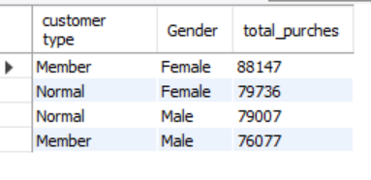
CUSTOMER ANALYSIS
INSIGHTS OF THE CUSTOMER ANALYSIS
customer type contributing the highest revenue
Female customers have purchesed more than
Male customers
Among female customers, members
have made more purches than the non members.
There is a slight defference between the total purches
for Normal male and Member male.
Females are generating more revenue than the male.

Slide 17

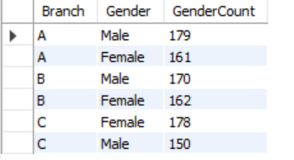

Females are most predominant genders among the customers.
Most of the ratings happened on Monday.
Branch A having the highest gender count when compared with branch B & C in both male and female.

Slide 18
SUGGESTIONS
The food and beverages are having highest sales, so focus on remaining product lines which is having least sales, implement the business strategies and enhance the performance to increase the sales in remaining product lines.
Start by understanding the needs of the customer and apply business strategies accordingly.
Implement new idealogies where the business units are weak.
Implement the good business strategies in the month of February and march to increase the sales value.
Females are generating more revenue than the male, so focus on male customers also, understand their requirements to increase sales of the male customers.

Slide 19


